Slide 1


Human - Computer
Interaction
Present by Chi Nguyen

Slide 2
CONTENTS
The human
The computer
The interaction
Paradigms

Slide 3
THE INTERACTION
WHAT IS THE INTERACTION?
INTERACTION STYLES
DIALOGUE … COMPUTER AND USER
DISTINCT STYLES OF INTERACTION
MODELS OF INTERACTION
SOME TERMS OF INTERACTION
NORMAN’S MODEL
INTERACTION FRAMEWORK
CONTEXT
ERGONOMICS
PHYSICAL ASPECTS OF INTERFACES
INDUSTRIAL INTERFACES
Notes:
A computer system is made up of various elements
Each of these elements affects the interaction
Input devices : text entry and pointing
Output devices : screen (small & large), digital paper
Virtual reality : speacial interaction and display devices
Physical interaction : sound, haptic, bio-sensing
Paper : as output (print) and input (scan)
Memory : RAM & permanent media, capacity & access
Processing : speed of processing, networks

Slide 4


WHAT IS INTERACTION?
Communication between user vs system

Slide 5
DOMAIN
  the area of work under study
GOAL
  what you want to achieve
TASK
  how you go about doing it
  ultimately in terms of operations or actions
note
  traditional interaction …
  use of terms differs a lot especially task/goal !!!
MODELS OF INTERACTION
SOME TERMS OF INTERACTION
NORMAN’S MODEL
INTERACTION FRAMEWORK

Slide 6
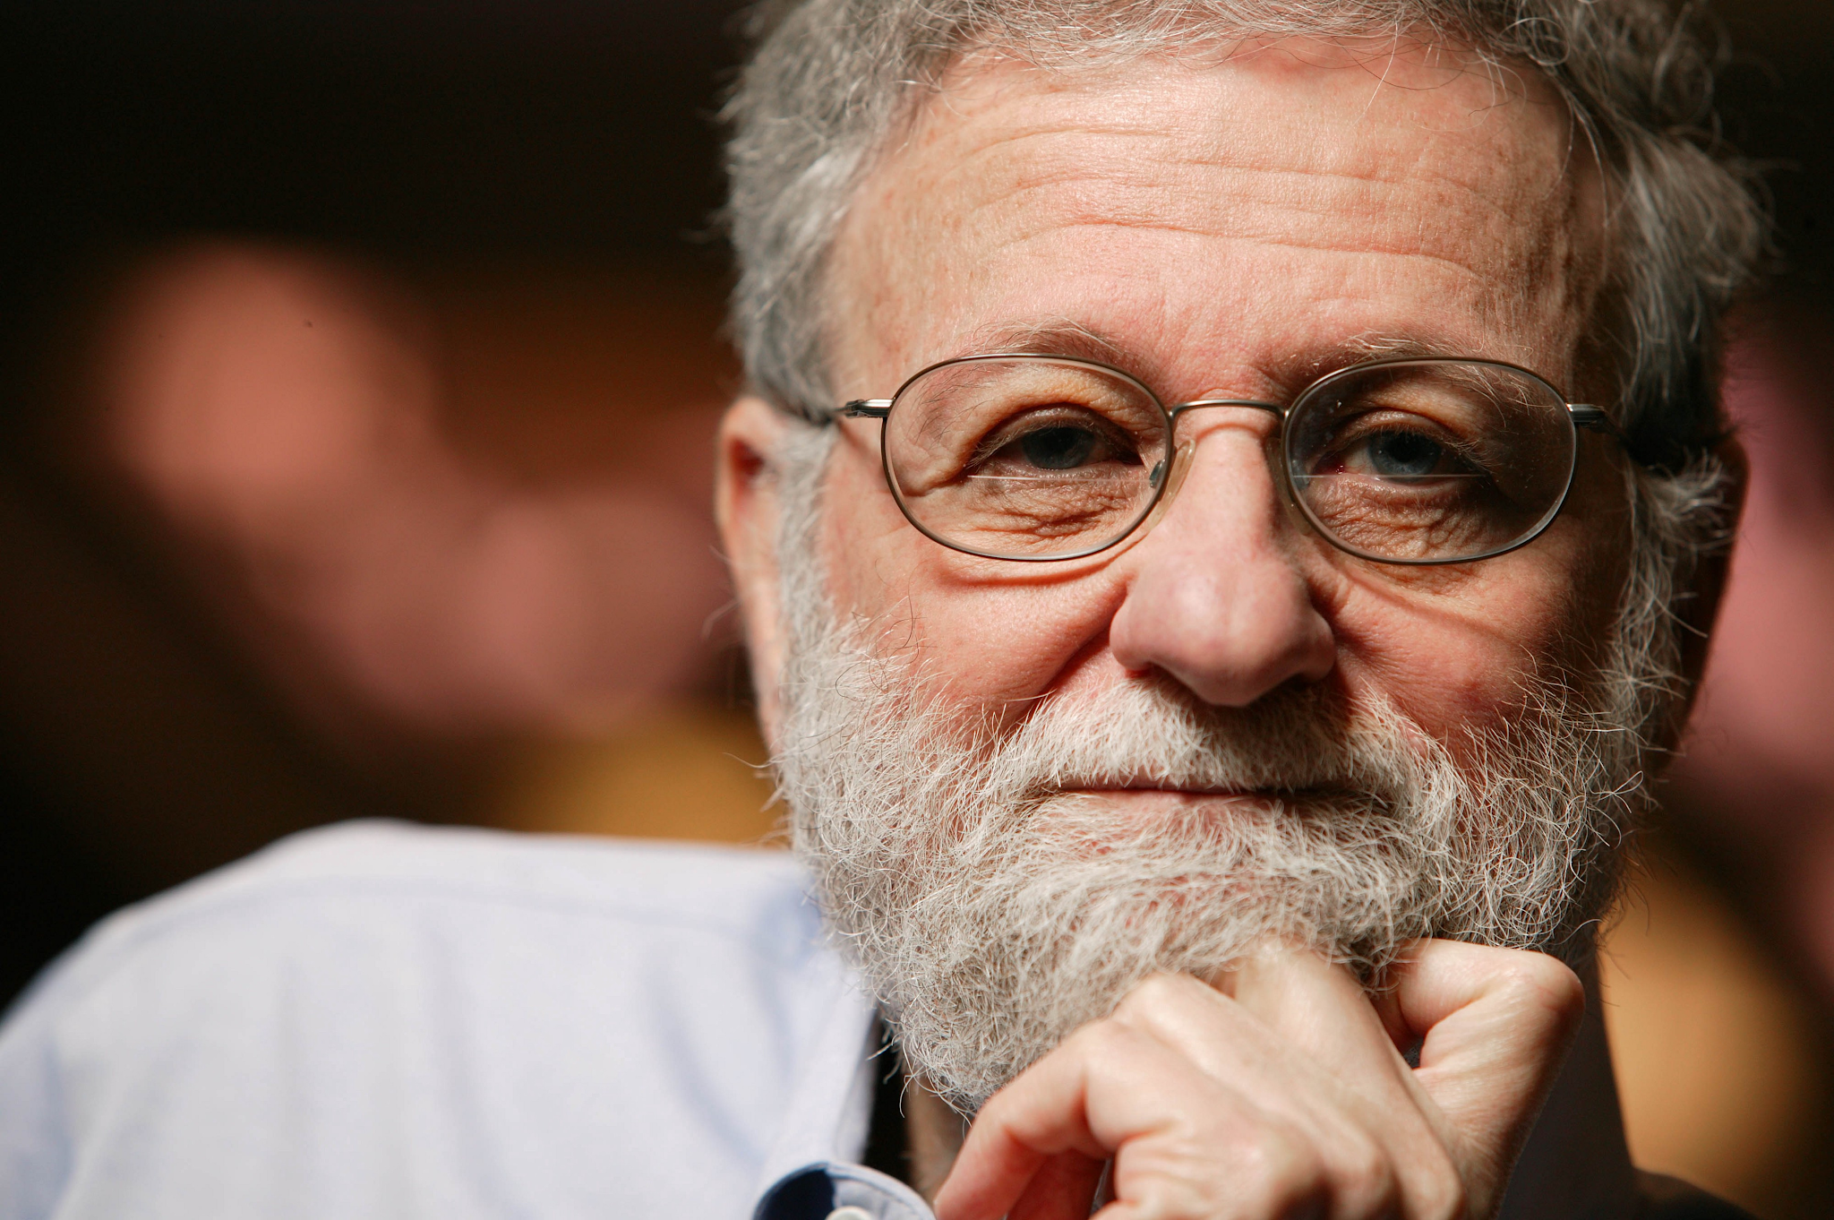
Donald Norman
  Donald Arthur Norman (born December 25, 1935)
  an American researcher, professor, and author
  He is widely regarded for his expertise in the fields of design, usability engineering, and cognitive science.
Seven stages
  user establishes the goal
  formulates intention
  specifies actions at interface
  executes action
  perceives system state
  interprets system state
  evaluates system state with respect to goal
Norman’s model concentrates on user’s view of the interface
MODELS OF INTERACTION
SOME TERMS OF INTERACTION
NORMAN’S MODEL
INTERACTION FRAMEWORK
Notes:
người dùng thiết lập mục tiêu
hình thành ý định
chỉ định các hành động tại giao diện
thực hiện hành động
nhận thức trạng thái hệ thống
diễn giải trạng thái hệ thống
đánh giá trạng thái hệ thống liên quan đến mục tiêu
Mô hình của Norman tập trung vào cách nhìn của người dùng về giao diện

Slide 7
EXECUTION / EVALUATION
LOOP
GOAL
EXECUTION
EVALUATION
Seven stages
  user establishes the goal
  formulates intention
  specifies actions at interface
  executes action
  perceives system state
  interprets system state
  evaluates system state with respect to goal
SYSTEM
Notes:
người dùng thiết lập mục tiêu
hình thành ý định
chỉ định các hành động tại giao diện
thực hiện hành động
nhận thức trạng thái hệ thống
diễn giải trạng thái hệ thống
đánh giá trạng thái hệ thống liên quan đến mục tiêu
Mô hình của Norman tập trung vào cách nhìn của người dùng về giao diện

Slide 8
EXECUTION / EVALUATION
LOOP
GOAL
User establishes the goal
EXECUTION
EVALUATION
Seven stages
  user establishes the goal
  formulates intention
  specifies actions at interface
  executes action
  perceives system state
  interprets system state
  evaluates system state with respect to goal
SYSTEM
Notes:
người dùng thiết lập mục tiêu
hình thành ý định
chỉ định các hành động tại giao diện
thực hiện hành động
nhận thức trạng thái hệ thống
diễn giải trạng thái hệ thống
đánh giá trạng thái hệ thống liên quan đến mục tiêu
Mô hình của Norman tập trung vào cách nhìn của người dùng về giao diện

Slide 9
EXECUTION / EVALUATION
LOOP
GOAL
User establishes the goal
EXECUTION
EVALUATION
Formulates intention
Specifies actions at interface
Executes action
Seven stages
  user establishes the goal
  formulates intention
  specifies actions at interface
  executes action
  perceives system state
  interprets system state
  evaluates system state with respect to goal
SYSTEM
Notes:
người dùng thiết lập mục tiêu
hình thành ý định
chỉ định các hành động tại giao diện
thực hiện hành động
nhận thức trạng thái hệ thống
diễn giải trạng thái hệ thống
đánh giá trạng thái hệ thống liên quan đến mục tiêu
Mô hình của Norman tập trung vào cách nhìn của người dùng về giao diện

Slide 10
EXECUTION / EVALUATION
LOOP
GOAL
User establishes the goal
EXECUTION
EVALUATION
Formulates intention
Specifies actions at interface
Executes action
Perceives system state
Interprets system state
Evaluates sytem stat
with respect to goal
Seven stages
  user establishes the goal
  formulates intention
  specifies actions at interface
  executes action
  perceives system state
  interprets system state
  evaluates system state with respect to goal
SYSTEM
Notes:
người dùng thiết lập mục tiêu
hình thành ý định
chỉ định các hành động tại giao diện
thực hiện hành động
nhận thức trạng thái hệ thống
diễn giải trạng thái hệ thống
đánh giá trạng thái hệ thống liên quan đến mục tiêu
Mô hình của Norman tập trung vào cách nhìn của người dùng về giao diện

Slide 11
USING
NORMAN’S
MODEL
EXECUTION
EVALUATION
Formulates intention
Specifies actions at interface
Executes action
Perceives system state
Interprets system state
Evaluates sytem stat
with respect to goal
SYSTEM
Some systems are harder
to use than others
Gulf of Execution
Gulf of Evaluation
User’s formulation of actions
≠ actions allowed by the system
User’s expectation of changed system state
≠ actual presentation of this state
Notes:
Vịnh thi hành
Công thức của người dùng về các hành động
≠ hành động được hệ thống cho phép
Vịnh đánh giá
Kỳ vọng của người dùng về trạng thái hệ thống đã thay đổi
≠ trình bày thực tế của trạng thái này

Slide 12
HUMAN ERROR -
SLIPS &
MISTAKES
SLIP
MISTAKE
Understand stystem & goal
Correct formulation of action
Incorrect action
May not even have right goal
FIXING THINGS?
SLIP - better interface design
MISTAKE - better understanding of system

Slide 13
ABOWD AND BEALE
FRAMEWORK
Output
Extension of Norman...
Their interaction framework has 4 parts
  User
  Input
  System
  Output
Each has its own unique language
Interaction ⇒ translation between languages
Problems in interaction = problems in translation
System
core
User
task
Input
Notes:
Mở rộng Norman ...
Khung tương tác của họ có 4 phần: Người sử dụng - Đầu vào - Hệ thống - Đầu ra
Mỗi thứ đều có ngôn ngữ độc đáo của riêng mình
Tương tác ⇒ dịch giữa các ngôn ngữ
Vấn đề trong tương tác = vấn đề trong bản dịch

Slide 14
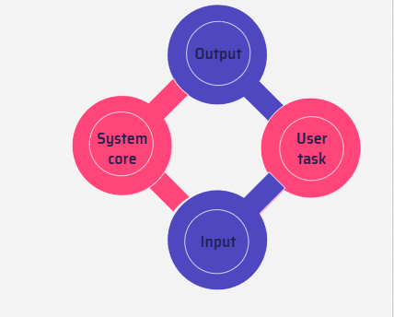
ABOWD AND BEALE
FRAMEWORK
User intentions
  Translated into actions at the interface
    Translated into alterations of system state
      Reflected in the output display
        Interpreted by the user
General framework for understanding interaction
  Not restricted to electronic computer systems
  Indentifies all major components involved in interaction
  An abstraction
Notes:
Ý định của người dùng
Được dịch thành các hành động tại giao diện
Được dịch thành các thay đổi của trạng thái hệ thống
Phản ánh trong màn hình đầu ra
Người dùng thông dịch
Khuôn khổ chung để hiểu sự tương tác
Không bị hạn chế đối với hệ thống máy tính điện tử
Xác định tất cả các thành phần chính liên quan đến tương tác
Một sự trừu tượng

Slide 15

ERGONOMICS
OR HUMAN FACTORS

Slide 16
“Ergonomics (or human factors) is the scientific discipline concerned with the understanding of the interactions among human and other elements of a system, and the profession that applies theory, principles, data and methods to design in order to optimize human well-being and overall system performance.”
International Ergonomics Association Executive Council, August 2000
Notes:
“Công thái học (hay yếu tố con người) là ngành khoa học liên quan đến sự hiểu biết về sự tương tác giữa con người và các yếu tố khác của hệ thống, và là ngành nghề áp dụng lý thuyết, nguyên tắc, dữ liệu và phương pháp để thiết kế nhằm tối ưu hóa sức khỏe con người và hiệu suất tổng thể của hệ thống. ”

Slide 17
physical aspects of interfaces
industrial interfaces
• Study of the physical characteristics of interaction
• Also known as human factors – but this can also be used to mean much of HCI!
• Ergonomics good at defining standards and guidelines for constraining the way we design certain aspects of systems
Alan Dix
- interaction-design.org
Notes:
• Nghiên cứu các đặc điểm vật lý
tương tác
• Còn được gọi là yếu tố con người - nhưng điều này cũng có thể được sử dụng để chỉ phần lớn HCI!
• Công thái học giỏi trong việc xác định các tiêu chuẩn và hướng dẫn để hạn chế cách chúng tôi thiết kế các khía cạnh nhất định của hệ thống
examples
• arrangement of controls and displays
e.g. controls grouped according to function or
frequency of use, or sequentially
• surrounding environment
e.g. seating arrangements adaptable to cope with all
sizes of user
• health issues
e.g. physical position, environmental conditions
(temperature, humidity), lighting, noise,
• use of colour
e.g. use of red for warning, green for okay,
awareness of colour-blindness etc.

Slide 18
DOMAINS OF SPECIALIZATION

Slide 19
DOMAINS OF SPECIALIZATION
PHYSICAL ERGONOMICS
COGNITIVE ERGONOMICS
ORGANIZATIONAL ERGONOMICS

Slide 20
DOMAINS OF SPECIALIZATION
PHYSICAL ERGONOMICS
COGNITIVE ERGONOMICS
ORGANIZATIONAL ERGONOMICS
Physical ergonomics is concerned with human anatomy, and some of the anthropometric, physiological and bio mechanical characteristics as they relate to physical activity
Cognitive ergonomics is concerned with mental processes, such as perception, memory, reasoning, and motor response, as they affect interactions among humans and other elements of a system.
Organizational ergonomics is concerned with the optimization of socio-technical systems, including their organizational structures, policies, and processes.

Slide 21
Office interface vs. industrial interface?
Context matters!
INDUSTRIAL INTERFACES
 | office | industrial
Type of data | textual | numeric
rate of change | slow | fast
environment | clean | dirty

Slide 22
• industrial interface:
– traditional …
INDUSTRIAL INTERFACES

Slide 23
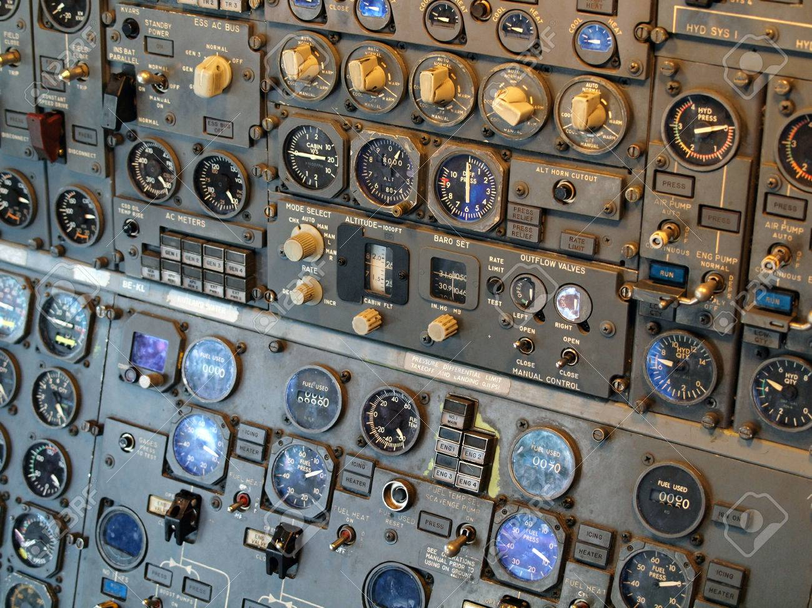
• industrial interface:
– traditional … dials and knobs
– now …
INDUSTRIAL INTERFACES

Slide 24
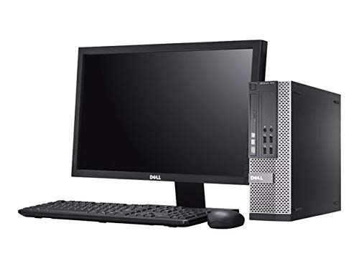
• industrial interface:
– traditional … dials and knobs
– now … screens and keypads
INDUSTRIAL INTERFACES

Slide 25
• industrial interface:
– traditional … dials and knobs
– now … screens and keypads
• glass interface
GLASS INTERFACES

Slide 26
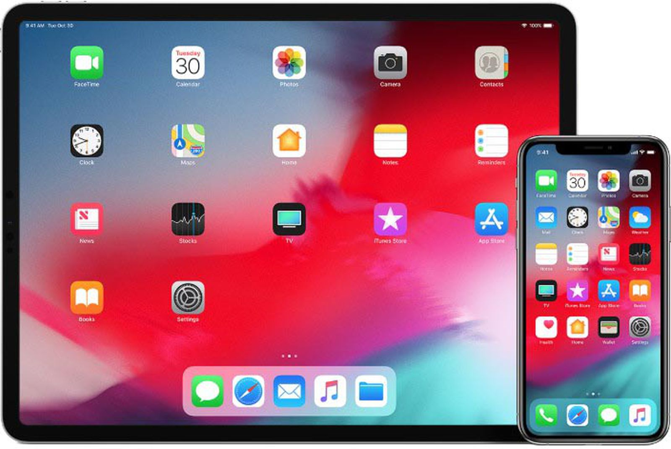
• industrial interface:
– traditional … dials and knobs
– now … screens and keypads
• glass interface
+ cheaper, more flexible,
multiple representations,
precise values
– not physically located,
Loss of context,
complex interfaces
• may need both
GLASS INTERFACES

Slide 27
Indirect manipulation
SYSTEM
• office– direct manipulation
– user interacts with artificial world

Slide 28
Indirect manipulation
PLANT
INTERFACE
• office– direct manipulation
– user interacts with artificial world
• industrial – indirect manipulation
– user interacts with real world through interface
• issues ..
– feedback
– delays
Immediate
feedback
Instruments

Slide 29
INTERACTION STYLES
dialogue … computer and user
distinct styles of interaction

Slide 30
COMMON INTERACTION STYLES
command line interface
menus
natural language
question/answer and query dialogue
form-fills and spreadsheets
WIMP
point and click
three–dimensional interfaces
Notes:
A computer system is made up of various elements
Each of these elements affects the interaction
Input devices : text entry and pointing
Output devices : screen (small & large), digital paper
Virtual reality : speacial interaction and display devices
Physical interaction : sound, haptic, bio-sensing
Paper : as output (print) and input (scan)
Memory : RAM & permanent media, capacity & access
Processing : speed of processing, networks

Slide 31
Command line interface
Way of expressing instructions to the computer directly
– function keys, single characters, short abbreviations, whole words, or a combination
Suitable for repetitive tasks
Better for expert users than novices
Offers direct access to system functionality
Command names/abbreviations should be
Meaningful!
Typical example: the Unix system

Slide 32
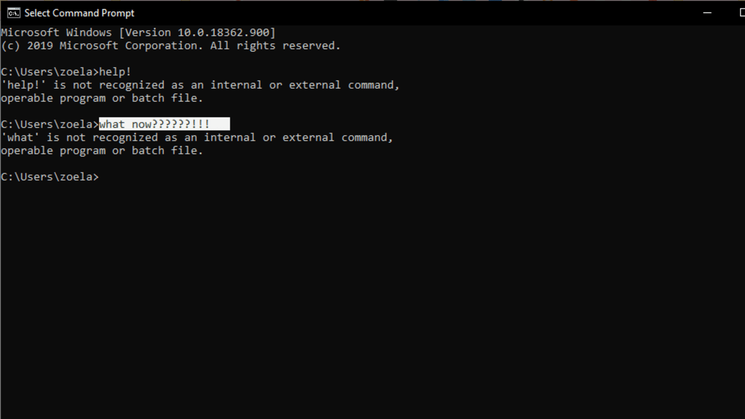
Command line interface

Slide 33
Menus
Set of options displayed on the screen
Options visible
– less recall - easier to use
– rely on recognition so names should be meaningful
Selection by:
– numbers, letters, arrow keys, mouse
– combination (e.g. mouse plus accelerators)
Often options hierarchically grouped
– sensible grouping is needed
Restricted form of full WIMP system

Slide 34
Natural language
Familiar to user
Speech recognition or typed natural language
Problems
– vague
– ambiguous
– hard to do well!
Solutions
– try to understand a subset
– pick on key words

Slide 35
Query interfaces
Question/answer interfaces
– user led through interaction via series of questions
– suitable for novice users but restricted functionality
– often used in information systems
Query languages (e.g. SQL)
– used to retrieve information from database
– requires understanding of database structure and language syntax, hence requires some expertise

Slide 36
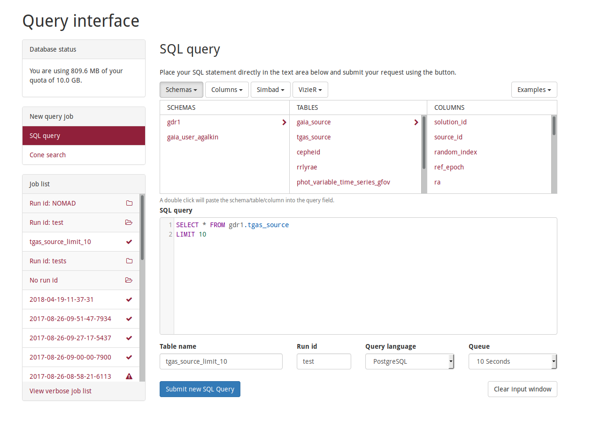
Query interfaces

Slide 37
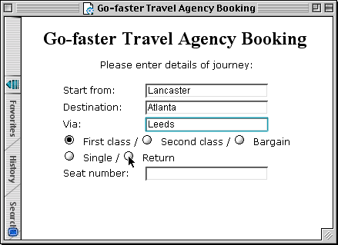
Form-fills
Primarily for data entry or data retrieval
Screen like paper form.
Data put in relevant place
Requires
– good design
– obvious correction facilities

Slide 38
Spreadsheets
First spreadsheet VISICALC, followed by Lotus 1-2-3
MS Excel most common today
Sophisticated variation of form-filling.
– grid of cells contain a value or a formula
– formula can involve values of other cells
e.g. sum of all cells in this column
– user can enter and alter data spreadsheet maintains consistency

Slide 39
WIMP Interface
Windows
  Icons
    Menus
      Pointers
… or windows, icons, mice, and pull-down menus!
default style for majority of interactive
computer systems, especially PCs and desktop
machines
elements of the wimp interface

Slide 40
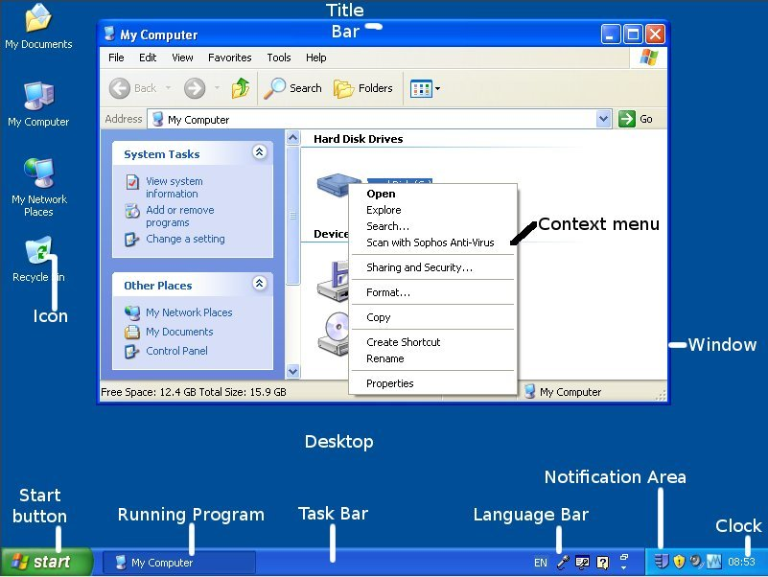
WIMP Interface
elements of the wimp interface

Slide 41
Point and click interfaces
Used in ..
– multimedia
– web browsers
– hypertext
Just click something!
– icons, text links or location on map
Minimal typing

Slide 42
Three dimensional interfaces
virtual reality
‘ordinary’ window systems
– highlighting
– visual affordance
– indiscriminate use just confusing!
3D workspaces
– use for extra virtual space
– light and occlusion give depth
– distance effects

Slide 43
ELEMENTS OF THE WIMP INTERFACE
Windows
  Areas of the screen that behave as if they were independent
  – can contain text or graphics
  – can be moved or resized
  – can overlap and obscure each other, or can be laid out next to one another (tiled)
  Scrollbars
  – allow the user to move the contents of the window up and down or from side to side
  title bars
  – describe the name of the window
Back

Slide 44
ELEMENTS OF THE WIMP INTERFACE
Icons
  Small picture or image
  Represents some object in the interface
  – often a window or action
  Windows can be closed down (iconised)
  – small representation fi many accessible windows
  Icons can be many and various
  – highly stylized
  – realistic representations.
Back

Slide 45
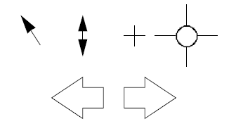
ELEMENTS OF THE WIMP INTERFACE
Pointers
  Important component
  – WIMP style relies on pointing and selecting things
  Uses mouse, trackpad, joystick, trackball, cursor keys or keyboard shortcuts
  Wide variety of graphical images
Back

Slide 46
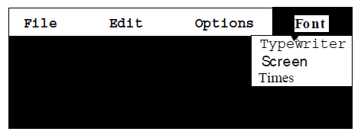
ELEMENTS OF THE WIMP INTERFACE
Menus
  Choice of operations or services offered on the screen
  Required option selected with pointer
  Problem – take a lot of screen space
  Solution – pop-up: menu appears when needed
Back

Slide 47
ELEMENTS OF THE WIMP INTERFACE
Back
Menu - Kinds of Menus
  Menu Bar at top of screen (normally), menu drags down
  – pull-down menu - mouse hold and drag down menu
  – drop-down menu - mouse click reveals menu
  – fall-down menus - mouse just moves over bar!
  Contextual menu appears where you are
  – pop-up menus - actions for selected object
  – pie menus - arranged in a circle
    easier to select item (larger target area)
    quicker (same distance to any option)

Slide 48
ELEMENTS OF THE WIMP INTERFACE
Back
Menu - Menus extras
  Cascading menus
  – hierarchical menu structure
  – menu selection opens new menu
  – and so in ad infinitum
  Keyboard accelerators
  – key combinations - same effect as menu item
  – two kinds
    active when menu open – usually first letter
    active when menu closed – usually Ctrl + letter
usually different !!!

Slide 49
ELEMENTS OF THE WIMP INTERFACE
Back
Menu - Menus design issues
  Which kind to use
  What to include in menus at all
  Words to use (action or description)
  How to group items
  Choice of keyboard accelerators

Slide 50
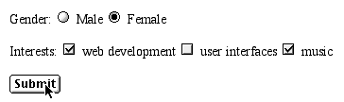
ELEMENTS OF THE WIMP INTERFACE
Back
Buttons
  Individual and isolated regions within a display that can be selected to invoke an action
  Special kinds
  – radio buttons
  – set of mutually exclusive choices
  – check boxes
  – set of non-exclusive choices

Slide 51
ELEMENTS OF THE WIMP INTERFACE
Back
Toolbars
  Long lines of icons …
  … but what do they do?
  Fast access to common actions
  Often customizable:
  – choose which toolbars to see
  – choose what options are on it

Slide 52
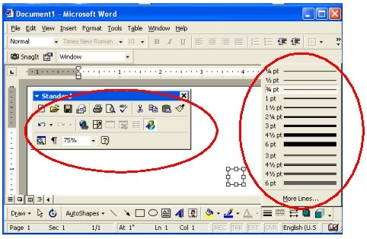
Back
Palettes and tear-off menus
  Problem
  menu not there when you want it
  Solution
    palettes – little windows of actions
    – shown/hidden via menu option
    e.g. available shapes in drawing package
    tear-off and pin-up menus
    – menu ‘tears off’ to become palette

Slide 53
ELEMENTS OF THE WIMP INTERFACE
Back
Dialogue boxes
  Information windows that pop up to inform of an important event or request information.
  e.g: when saving a file, a dialogue box is displayed to allow the user to specify the filename and location. Once the file is saved, the box disappears.

Slide 54
INTERACTIVITY
easy to focus on look
what about feel?

Slide 55
Speech–driven interfaces
Rapidly improving …
… but still inaccurate
How to have robust dialogue?
… interaction of course!
e.g. airline reservation:
reliable “yes” and “no”
+ system reflects back its understanding
“you want a ticket from New York to Boston?”

Slide 56
Look and
… feel
WIMP systems have the same elements:
windows, icons., menus, pointers, buttons, etc.
but different window systems
… behave differently
e.g. MacOS vs Windows menus
appearance + behaviour = look and feel

Slide 57
Initiative
Who has the initiative?
old question–answer – computer
WIMP interface – user
WIMP exceptions …
pre-emptive parts of the interface
Modal dialog boxes
– come and won’t go away!
– good for errors, essential steps
– but use with care

Slide 58
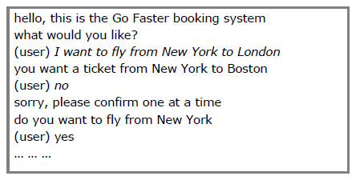
Error and repair
can’t always avoid errors …
… but we can put them right
make it easy to detect errors
… then the user can repair them

Slide 59
Context
Interaction affected by social and organizational context
Other people
– desire to impress, competition, fear of failure
Motivation
– fear, allegiance, ambition, self-satisfaction
Inadequate systems
– cause frustration and lack of motivation

Slide 60
EXPERIENCE, ENGAGEMENT AND FUN
designing experience
physical engagement
managing value

Slide 61
Experience?
Home, entertainment, shopping
– not enough that people can use a system
– they must want to use it!
Psychology of experience
– flow (Csikszentimihalyi)
– balance between anxiety and boredom
Education
– zone of proximal development
– things you can just do with help
Wider …
– literary analysis, film studies, drama

Slide 62
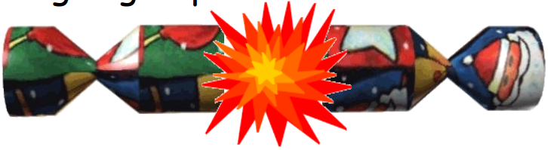

Designing experience
Real crackers
– cheap and cheerful!
– bad joke, plastic toy, paper hat
– pull and bang
Virtual crackers
– Cheap and cheerful
– Bad joke, web toy, cut-out mask
– Click and bang

Slide 63
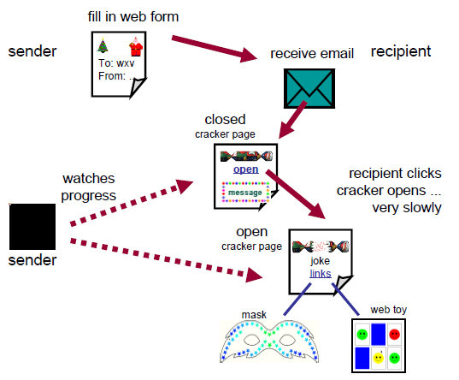
how crackers work

Slide 64
The crackers experience
 | real cracker | virtual cracker
Surface elements - design - Play - dressing up | - cheap and cheerful simple - plastic toy and joke - paper hat | - simple page/graphics - web toy and joke - mask to cut out
Experienced effects - shared - co-experience - excitement - hiddenness - suspense - surprise | - offered to another - pulled together - cultural connotations - contents inside - pulling cracker | - sent by email message - sender can't see content until opened by recipient - recruited expectation - first page - no contents - slow ... page change - WAV file (when it works)

Slide 65
Physical design
many constraints:
– ergonomic – minimum button size
– physical – high-voltage switches are big
– legal and safety – high cooker controls
– context and environment – easy to clean
– aesthetic – must look good
– economic – … and not cost too much!

Slide 66
Design trade-offs
constraints are contradictory … need trade-offs
within categories:
e.g. safety – cooker controls
front panel – safer for adult
rear panel – safer for child
between categories
e.g. ergonomics vs. physical – MiniDisc remote
ergonomics – controls need to be bigger
physical – no room!
solution – multifunction controls & reduced functionality

Slide 67
Fluidity
do external physical aspects reflect logical effect?
– related to affordance
logical state revealed in physical state?
e.g. on/off buttons
inverse actions inverse effects?
e.g. arrow buttons, twist controls
Notes:
Fluidity : tính linh hoạt
Affordance: khả năng phản hồi

Slide 68
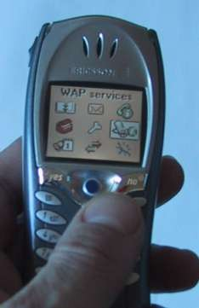
Inverse actions
yes/no buttons
‘joystick’
also left side control

Slide 69
spring back controls
one-shot buttons
joystick
some sliders
good – large selection sets
bad – hidden state

Slide 70
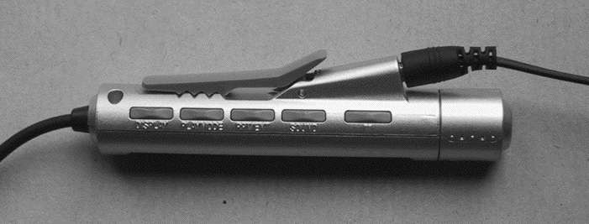
a minidisc controller
series of spring-back controls
each cycle through some options
–natural inverse back/forward
Twist of track movement
pull and twist of volume
Spring back
Natural inverse for twist

Slide 71
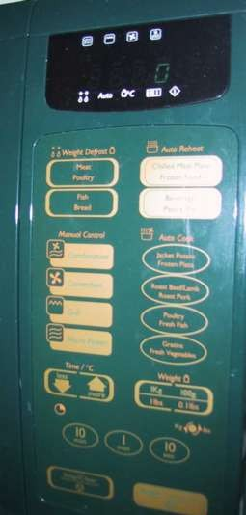
physical layout
Controls:
logical relationship
~ spatial grouping

Slide 72
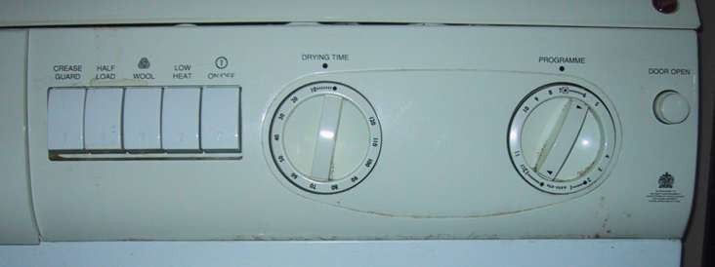
compliant interaction
state evident in
mechanical buttons
rotary knobs reveal internal state
and can be controlled by both user and machine

Slide 73
Managing value
people use something
ONLY IF
it has perceived value
AND
value exceeds cost
BUT NOTE
  exceptions (e.g. habit)
  value NOT necessarily personal gain or money

Slide 74
Weighing up value
Value
  helps me get my work done
  Fun
  good for others
Cost
  download time
  money £, $, €
  learning effort

Slide 75
Discounted future
in economics Net Present Value:
– discount by (1+rate)years to wait
in life people heavily discount
– future value and future cost
– hence resistance to learning
– need low barriers and high perceived present value

Slide 76
Value and organisational design
Coercion
  tell people what to do!
  value = keep your job
Enculturation
  explain corporate values
  establish support (e.g share options)
Emergence
  design process so that
  individuals value → organisational value

Slide 77
GENERAL LESSON
if you want someone to do something …
make it easy for them!
understand their values

Slide 78
Thanks!
Do you have any questions?
chrizmonkey@gmail.com
+84 0937 566 561

